Slide 1





Towards General Robustness Verification of MaxPool-based Convolutional Neural Networks via Tightening Linear Approximation
Yuan Xiao, Shiqing Ma, Juan Zhai, Chunrong Fang, Jinyuan Jia, Zhenyu Chen
Poster: 17:15 - 18:45, Friday, June 21
Project page: https://github.com/xiaoyuanpigo/maxlin
Notes:
Hello, I am Yuan xiao from Nanjing university, thank you for your attention to our work at cvpr 2024.

Slide 2
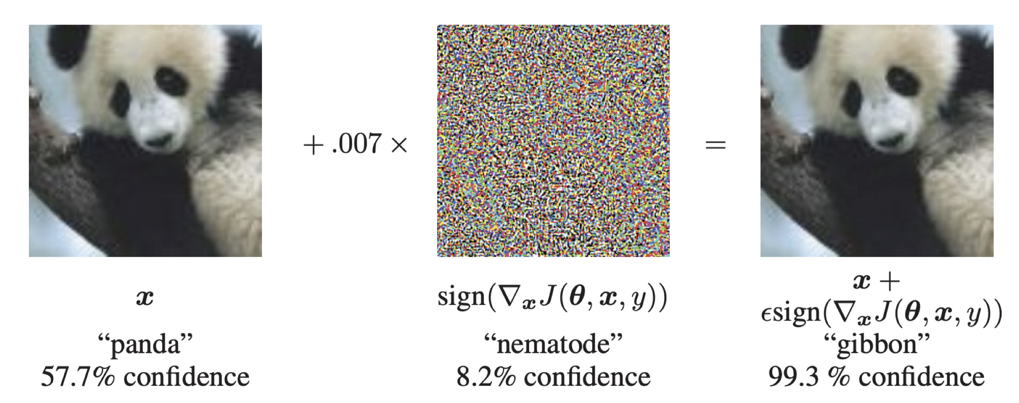
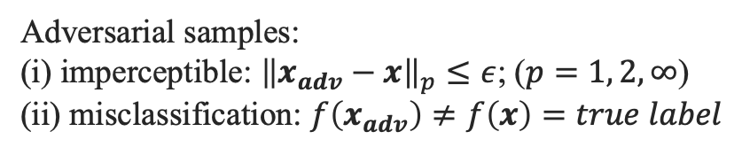
Summary
Background
Neural Networks are vulnerable to adversarial attacks
Adversarial samples:
(i) imperceptible: ${\left\|x_{adv}−x\right\|}_{p}≤ε$; ($p=1, 2, ∞$)
(ii) misclassification: $f\left(x_{adv}\right)≠f\left(x\right)=true label$
MaxPool is commonly used in CNNs but hard to verify.
Notes:
Convolutional neural networks (CNNs) have achieved remarkable success in various applications.
However, accompanied by outstanding effectiveness, it are often vulnerable to adversarial attacks. Such. fragility can be quantified by formal verification by providing a certified lower bound within which any perturbation does not alter the original input’s classification result. However, it is challenging due to nonlinear components, such as MaxPool.

Slide 3
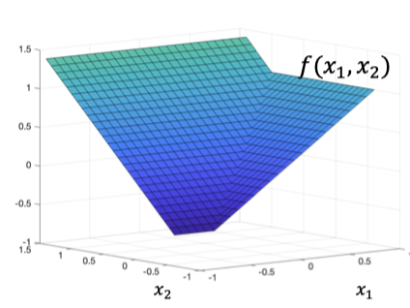
Summary
Background
Neural Networks are vulnerable to adversarial attacks
Adversarial samples:
(i) imperceptible: ${\left\|x_{adv}−x\right\|}_{p}≤ε$; ($p=1, 2, ∞$)
(ii) misclassification: $f\left(x_{adv}\right)≠f\left(x\right)=true label$
MaxPool is commonly used in CNNs but hard to verify.
Existing work
MaxPool Layer
Linear Bounds
Upper Linear Plane
Lower Linear Plane
Notes:
Until recently, some attempts have been made to certify the robustness of MaxPool-based CNNs.
Unfortunately, these existing methods are limited in terms of efficiency and precison. As they only focus on one non-linear layer and overlook the the interleavings between layers.

Slide 4
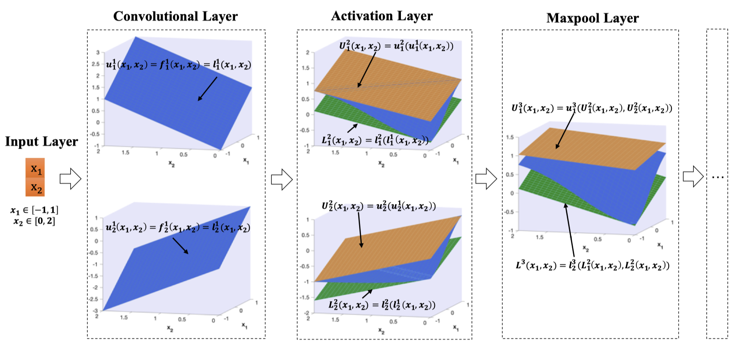
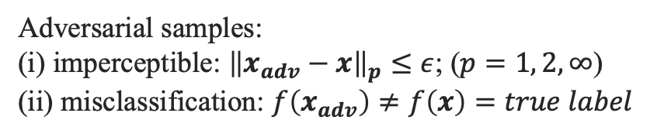
Summary
Background
Neural Networks are vulnerable to adversarial attacks
Adversarial samples:
(i) imperceptible: ${\left\|x_{adv}−x\right\|}_{p}≤ε$; ($p=1, 2, ∞$)
(ii) misclassification: $f\left(x_{adv}\right)≠f\left(x\right)=true label$
MaxPool is commonly used in CNNs but hard to verify.
Existing work
Our proposed method: MaxLin
MaxPool Layer
Linear Bounds
Upper Linear Plane
Lower Linear Plane
Notes:
To address the above challenges, in this work, we propose MaxLin, an efficient and tight verification framework for MaxPool-based networks via tightening linear approximation. We also prove that our proposed upper bound is block-wise tightest. Compared with existing neuron-wise tightness, our method acheives better certified results.

Slide 5
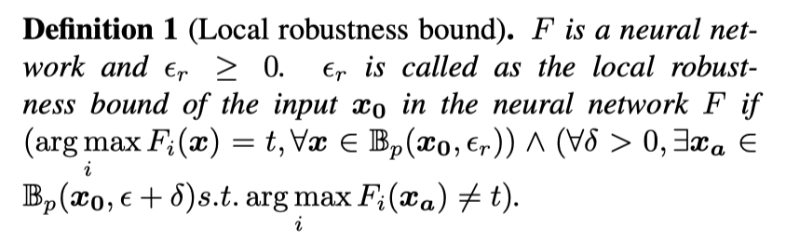
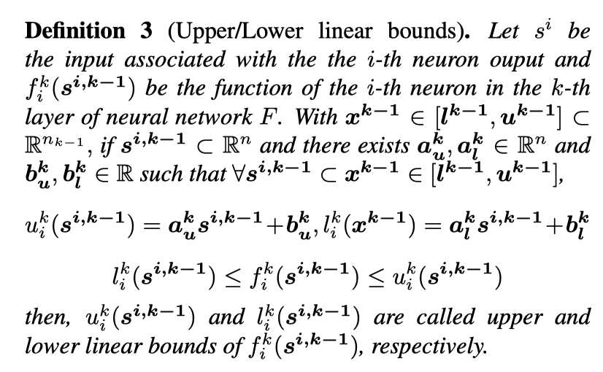
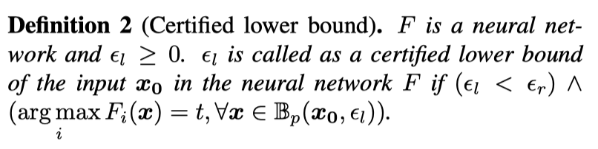
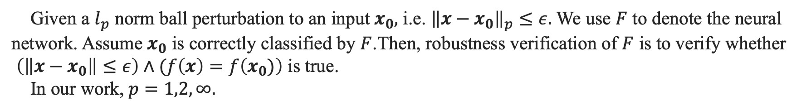
Preliminaries
Robustness verification
Given a $l_{p}$ norm ball perturbation to an input $x_{0},$ i.e. ${\left\|x−x_{0}\right\|}_{p}≤ε.$ We use $F$ to denote the neural
network. Assume $x_{0}$ is correctly classified by $F$.Then, robustness verification of $F$ is to verify whether
$\left(\left\|x−x_{0}\right\|≤ε\right)∧(f\left(x\right)=f\left(x_{0})\right)$ is true.
In our work,$p=1,2,∞.$
Robustness Results
Linear Approximation
Notes:
The whole problem of robustness verification can be transferred to calculating the absolute safe radius as shown in definition 1 and 2. In this work We use linear approximation to bound the non-linear Layers, which can efficiently handle complex functions beyond univariate functions, such as maxpool

Slide 6
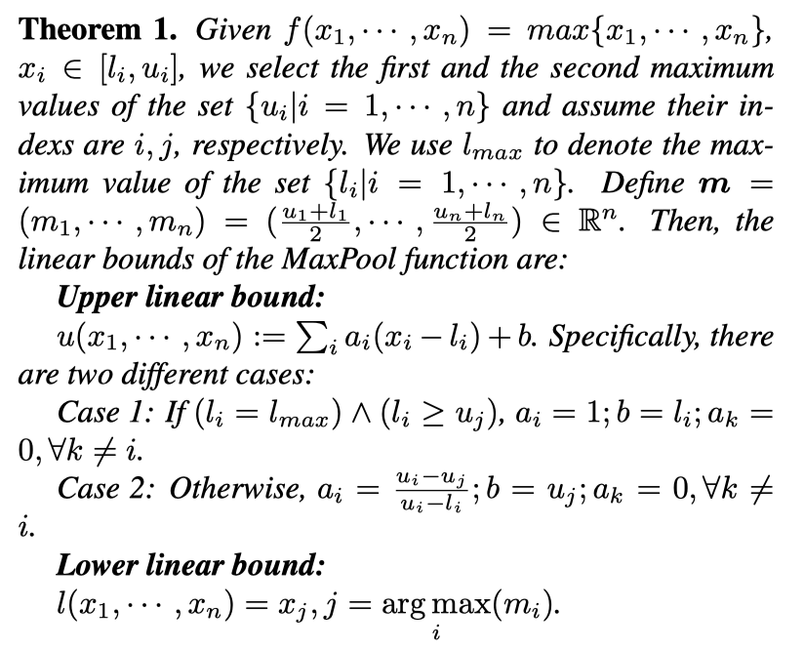
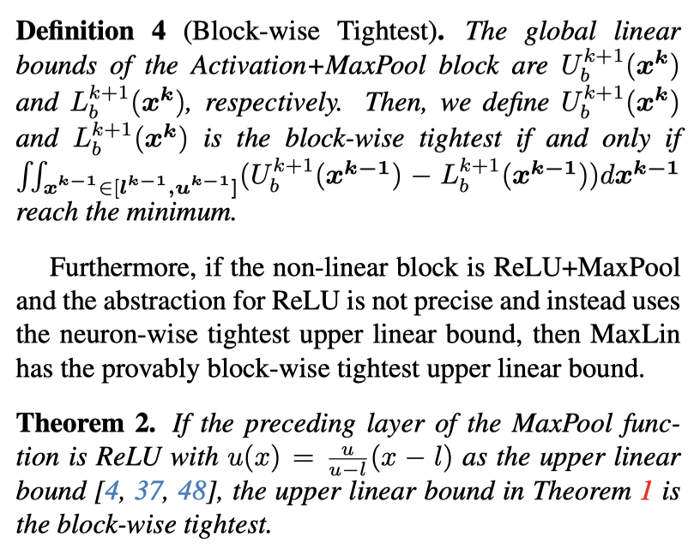
Methodology
Tight Linear Approximation for MaxPool.
Block-wise Property
Notes:
In this paper, we introduce the notion of block-wise tightest, that is, the volume of the over-approximation zone between the global linear bounds of the ReLU+MaxPool block is the minimum.
This notion considers the interleavings of neurons, and the achieved results will be superior to existing neuron-wise tightest.

Slide 7
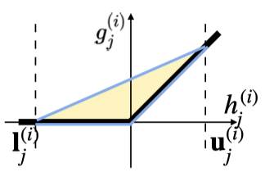
Methodology
Upper linear bound for ReLU
Tight Linear Approximation for MaxPool.
Block-wise Property
Notes:
Furthermore, if the non-linear block is ReLU+MaxPool and the abstraction for ReLU is not precise and instead uses the neuron-wise tightest upper linear bound, then The upper linear in Theorem 1 is provably block-wise tightest.

Slide 8
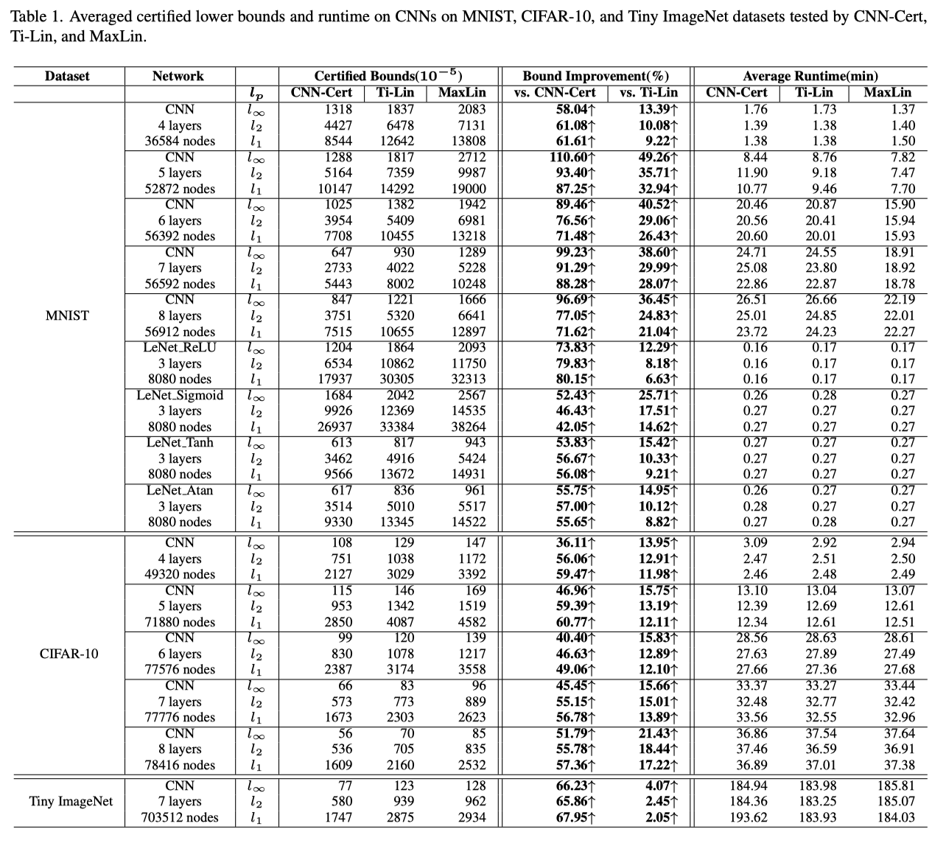
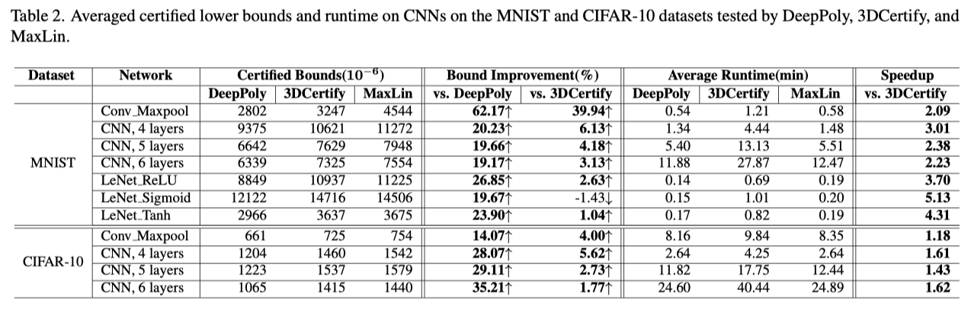
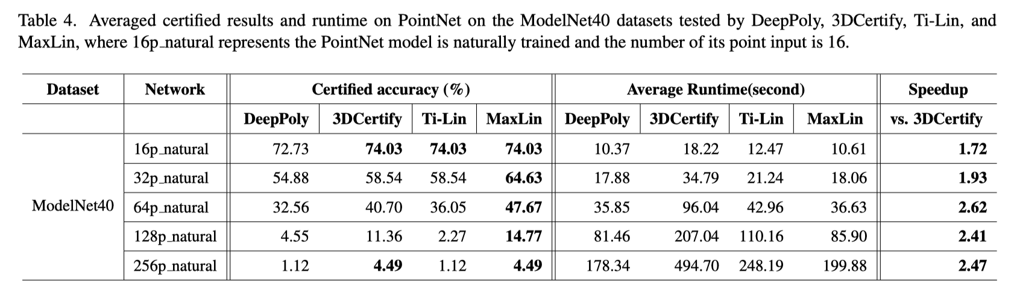
Experimental results
Comparison with backsubstitution-based methods
(i) Performance atop CNN-Cert
(ii) Performance atop ERAN
Notes:
Our verifier is built atop backsubstitution-based verifier, like CNN-Cert and ERAN, which uses linear approximation to compute the bounds of the output neurons and achieves a good balance between precision and efficiency. The results are as shown above.

Slide 9
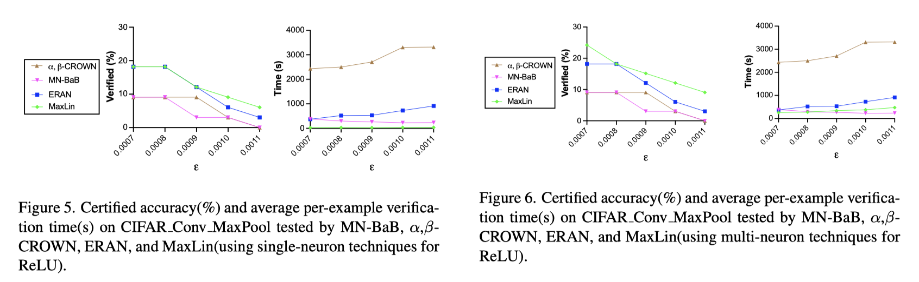
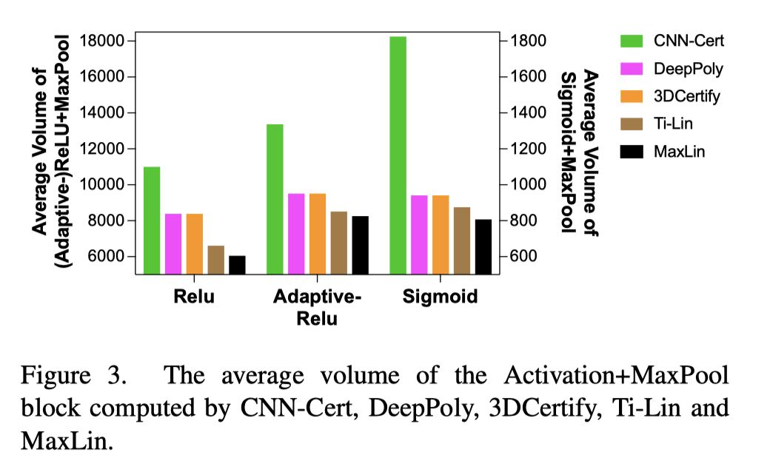
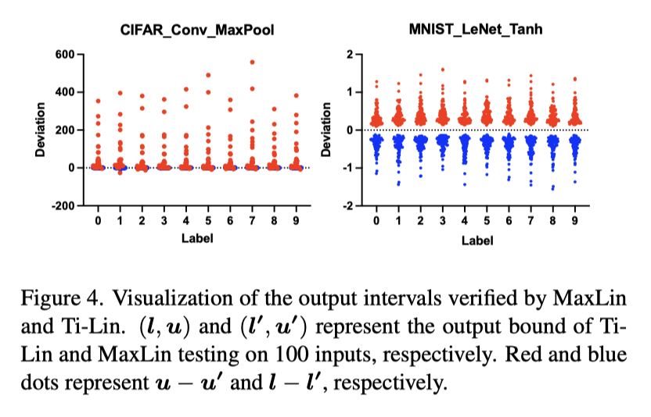
Experimental results
Comparison with BaB (branch and bound)-based methods
Evaluating the block-wise tightness
Notes:
We also compare our method to other types of verification framework, such branch and bound. And the results are shown in Figure 5 and 6. Additionaly, we compute the average volume of the activation +maxpool blocks and the raw output intervals of these methods to further illustrate the advantage of block-wise tightest upper linear bounds.

Slide 10


Thanks!
Project page:
https://github.com/xiaoyuanpigo/maxlin
Paper: MaxLin
Notes:
More details are available on the project and paper page . Please feel free to contact us with any questions. Thanks again for your time!

